Slide 1

LIFE LINE: Revolutionizing Blood Management
A comprehensive platform for a healthier tomorrow.

Slide 2

Introduction to Life Line
Life Line is a full-fledged web-based platform designed to manage and automate the blood donation process. It bridges the gap between donors, recipients, and hospitals through a centralized online system, enabling real-time emergency blood request handling, smart donor matching, and inventory management accessible from anywhere. With its browser-based interface and cloud-backed architecture, Life Line ensures fast, secure, and seamless coordination among all stakeholders.
Life Line – Unique Web-Based Features
Live Blood Inventory Heatmap
Interactive map view showing real-time blood stock availability.
Color-coded pins (Green = surplus, Yellow = moderate, Red = urgent shortage).
Search and filter by blood group, city, or hospital.

Slide 3


Smart Donation Scheduling
Automatically calculates the next eligible donation date for each donor.
Sends gentle reminders (email, SMS, or WhatsApp).
Provides a calendar booking system for nearby blood drives.

Slide 4
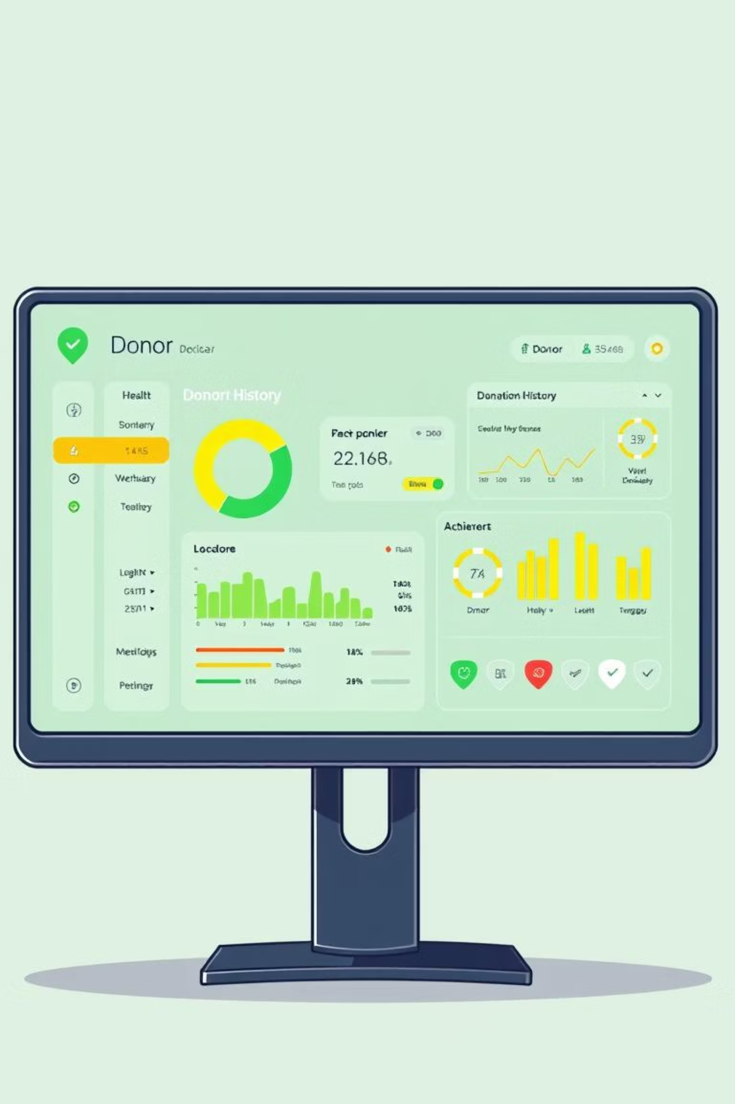

Donor Health Dashboard
Tracks donation history, hemoglobin levels, and eligibility status.
Displays recovery status post-donation.
Badges & streaks: “Regular Donor,” “First Responder,” “Top Contributor.”

Slide 5
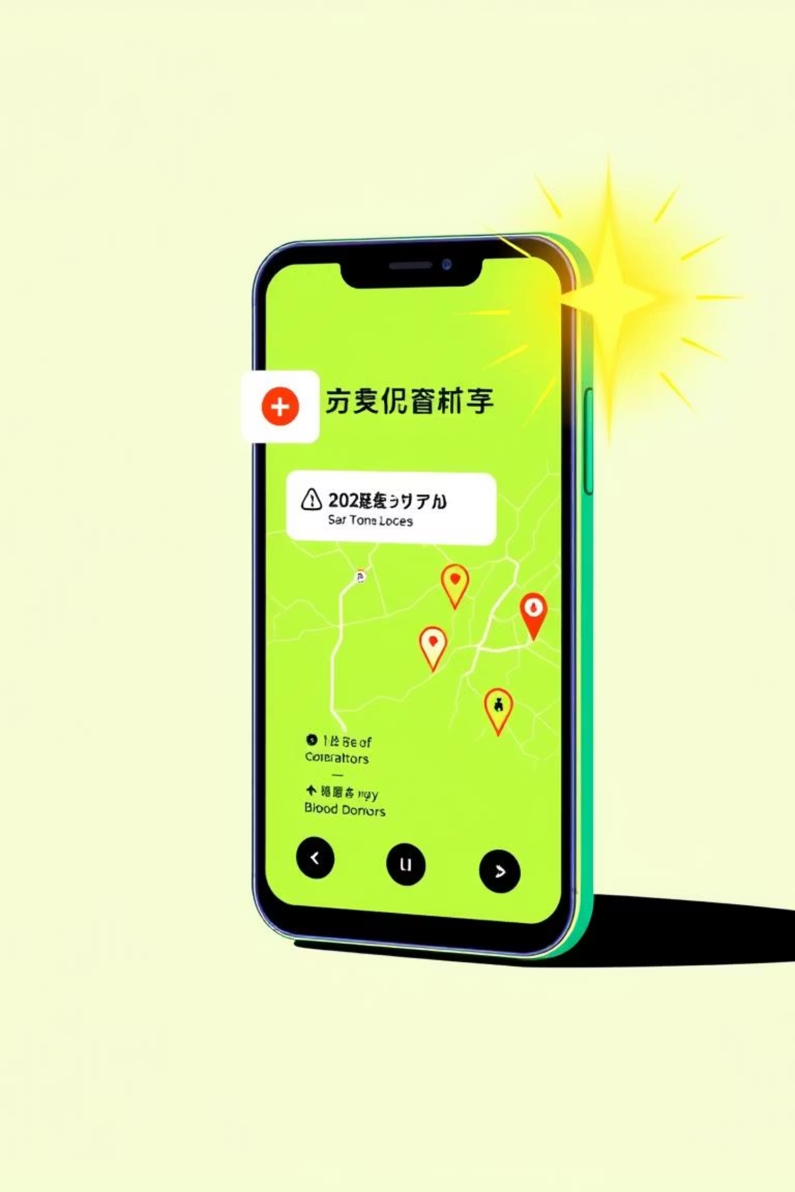

Emergency Circle Alert
Creates location-based donor clusters.
During urgent requests, pings all nearby eligible donors.
Prioritizes based on distance and availability (saves time in crisis).

Slide 6
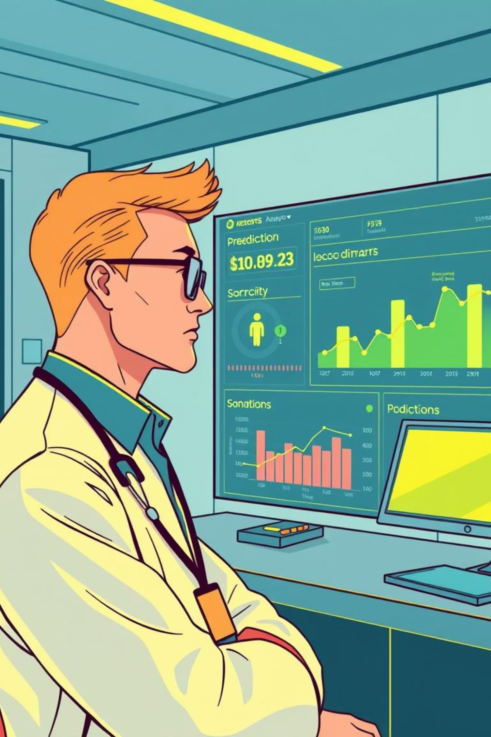

Analytics & Insights Panel
Provides predictive analytics for hospital administrators:
Upcoming demand forecasts.
Predicts blood group scarcity.
Seasonal/weekly donation trends.
Helps them plan blood drives proactively.

Slide 7


Community Engagement
Lets donors form Donor Circles (college groups, workplaces, local clubs).
Shows impact score: “Your circle saved 57 lives this year!”
Encourages friendly competition between groups.

Slide 8
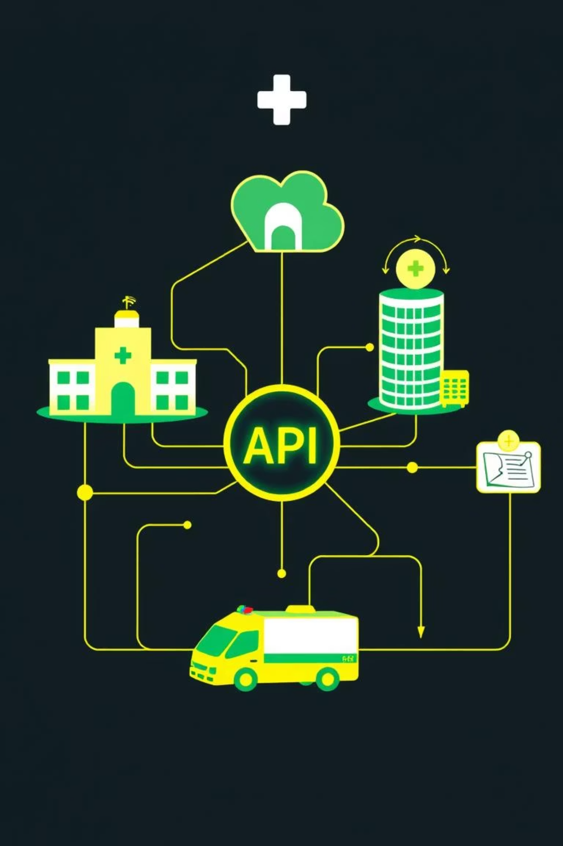

Public API for Integration
Allows hospitals, ambulances, and NGOs to integrate directly:
Auto-sync inventory levels.
Auto-raise blood requests when stock drops.
Makes Life Line a hub for the healthcare ecosystem.

Slide 9


Disaster Mode Switch
Activates during major accidents or natural disasters.
Prioritizes emergency requests over routine ones.
Shows only active donors and nearest hospitals to speed rescue.
Can be triggered manually by an administrator or automatically based on incoming requests.

